Slide 1
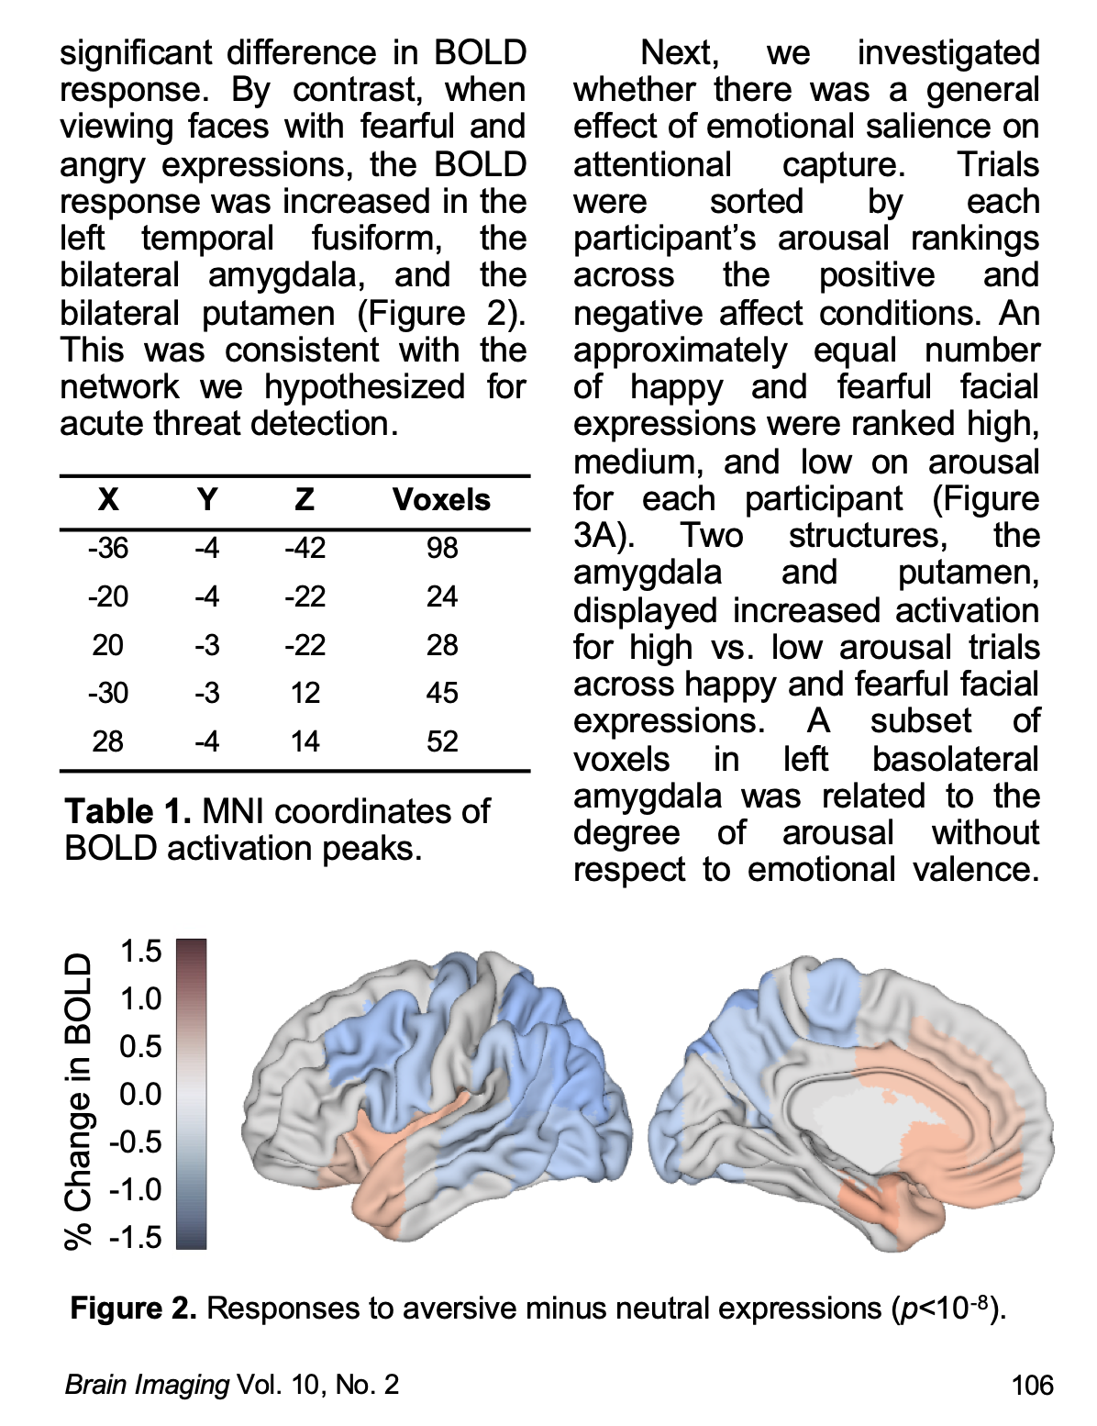
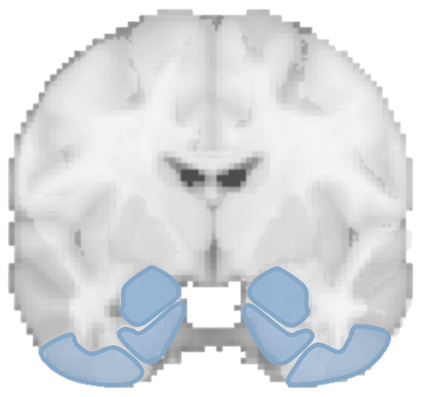
DOMAIN
text processing
behaviors
machine learning
mental functions
paradigms
meta-analysis

